Slide 2
Oscied
Bram Tullemans
Senior project manager
Software platforms and broadband networks
Open source cloud infrastructure for encoding to distribution

Slide 3
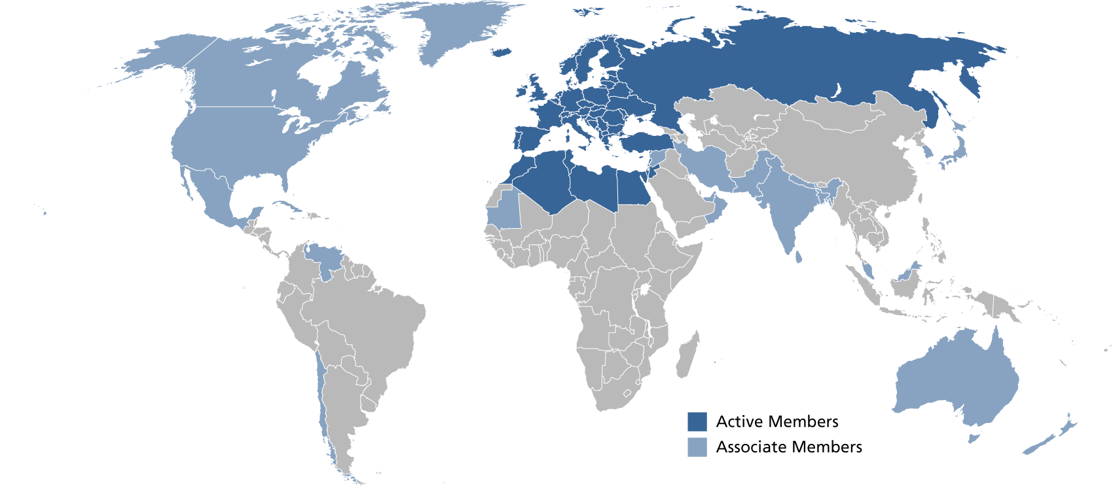

European Broadcasting Union – Eurovision
85 active members
in 56 countries and
35+ associate members around the world
500+ TV channels
1000+ radio channels
200+ million TV HH

Slide 4
EBU Technology & Innovation
MISSION:
A common interest to cooperate and act on a European and worldwide level
To connect people and share their experiences and best practices
To advise and guide in technology developments and decisions
To drive innovation and develop the future of media in the best conditions for PSM and citizens
To promote and represent our values and insights in standardization, regulatory and industrial bodies
To harmonize market implementations and strive for interoperability
High level objectives
with the aim to
maximize COST and EFFICIENCY
improve QUALITY OF SERVICE and EXPERIENCE
maximize REACH
optimize STRATEGIC POSITIONING

Slide 5

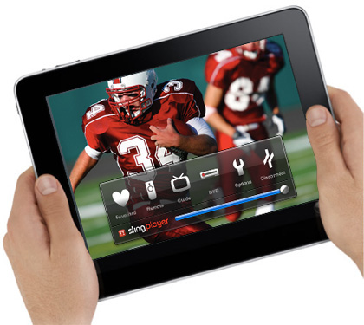
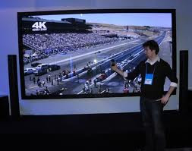
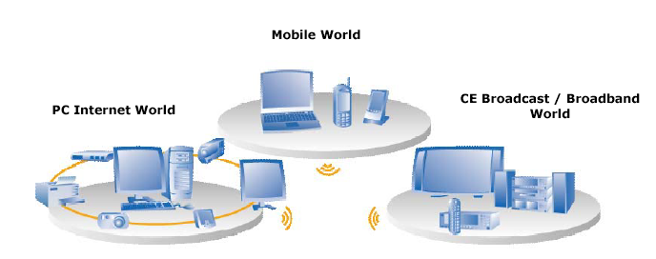
Media DRIVEN by user context & Usage
Mobile context
Personal context
Shared context
Intentional use
Interactivity
Attention span
Screen size
Quality

Slide 6
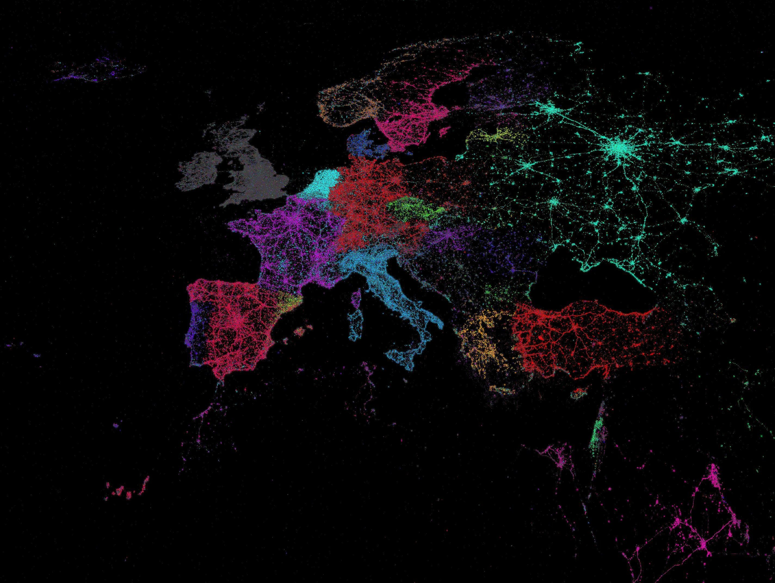
Source picture: Twitter

Slide 7
Merging linear with on demand
Development of hybrid services allowing users to switch seamlessly between linear and on-demand services adding interactivity and personalisation while keeping universal coverage by combining different distribution platforms and choice of access by end user.
Best of both worlds approach: Use broadcast techniques for massive distribution of linear content and internet for personalisation, interaction and on-demand.
Hybrid Broadband Broadcast
HbbTV standardisation:
Hybrid Radio, Radio.dns
Second Screen synchronisation

Slide 8
Use cases CDN for broadcasters
Offload traffic
Only distribution of media files
Outsourcing distribution platform
In practice:
Smaller countries use one CDN to offload traffic
Bigger countries use multiple CDNs to manage traffic flows
Broadcasters want QoS and QoE:
Managed services over broadband networks have SLAs in place controlling end to end delivery = QoS
Best effort network is a domain where only optimisation of quality can be reached = QoE

Slide 9
Some possible futures
Broadcasters will use CDN-Overlay
CDN Federation to manage data flows
Broadcasters will run their own CDN
Open CDN interfaces are needed in all scenarios!
Meanwhile: CDN becomes cloud service
Cloud operators will deliver CDN solutions
CDNs probably will deliver Cloud services
Hence all the talk about SDNs and OpenFlow!

Slide 10


Open ContEnt Aware (OCEAN) Architecture
Shape the evolution of Content Distribution Architectures, in line with regulation context, end-users expectations and providers requirements
A new OPEN architecture to foster multi-vendor solutions, cut down content delivery cost and give better investment incentives for European players
Popularity tracking and caching algorithm, content aware congestion control, distributed delivery systems

Slide 11
Virtualisation motivators
Production domain
File based production in decentralised but networked environment
Specific recording and editing choices for different screen sizes and publication platforms
Communicating workflows, for example to aggregate metadata on all levels
Distribution domain
Fragmented playout cababilities playout devices and fast changing technology / standards
To improve user experience all the content needs to be cached deep into the network as close as possible to the end user
Personalisation and interactivety needs
Fast scaling infrasturctures to adapt to sudden changing audience consumption patters
Digital fyber backbone connecting gateways, caches and antennas

Slide 12






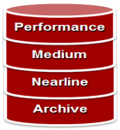
Media Delivery:
Self operated CDN platforms (caching, audio live streaming, HBB TV)
Peerings / uplinks to swiss internet providers at two internet peering points in Switzerland
Global loadbalancing / Trafficmanagement (dyn)
Akamai
www : 2x 9 Gbps (shared for all purposes of SRG)
traffic forecast 2013: 29 PB Akamai / 23 PB self operated CDN
Traffic Management
Akamai
WWW
Internet; Peering
On premise CDN Platform
Automation: Common platformservice for all corporate units
Puppet, Icinga, Graylog, HA-Proxy, Pakiti, shared repos, ....
Dedicated application services according the different architecture of the SRG units
Cloud orchestration
RESTful API ; Self service portal (web frontend)
Usage based billing (on hourly basis)
Completely seperated environments (test, integration, dev, prod)
OS agnostic
Computing
Hypervisor: Vmware
Servers: Cisco UCS blades (2 sites)
All connections on 10 GE
Computing
Storage (VoD, shared Storage)
EMC, 5 different tiers
Block level replicated over 2 sites
NFS, CIFS
WAN / Core network
Dark fibre ring around Switzerland
Mulitple 10 GE
Connecting all corporate units (offices, encoding stations, datacenters, archives, ...)
Corporate core network

Slide 13
Oscied basics
Scalable cloud infrastructure
Virtualisation of storage, encoding and distribution
Elasticity: Fast up-/down-scaling in private and public cloud
Manageable services
Control scaling of virtual services in hybrid cloud
Manage settings and control costs
All components are open source
Library of code embedded in functional service
Fast interchange of knowledge
Availability of development communities
Modular development
Use of interchangeable modules
Decentralised parallel development

Slide 14
Oscied development cycles
Basic code (current / first development cycle)
Scalable transcoding (ffmpeg)
Flexible HA storage (GlusterFS)
Elastic distribution (Apache + Unified Streaming Mod264).
Deployment made easy by Canonical's Juju services orchestrator
Strong plug-and-play design of interconnected services (e.g. with reverse proxies, NGINX, databases, ...)
Current developments
A professional management layer for the system as a whole will be at the core of this system.
MPEG DASH, both for Live and VOD and play out to different devices (laptop, HbbTV, Tablet and Smartphone both for Android and iOS).
Optimisation of distribution by adding automated management of data flows
Automation of broadcast processes

Slide 15
Cloud infrastructure for broadcasters
PRIVATE CLOUD
Management layer
WebUI and Orchestrator
Virtual machines for storage
Virtual machines for encoding
Virtual machines for distribution
Public CLOUD
Management layer
WebUI and Orchestrator
Virtual machines for storage
Virtual machines for encoding
Virtual machines for distribution

Slide 16
Cloud infrastructure for broadcasters
Management layer in hybrid cloud
Allow professional users to manipulate setting of the storage nodes, virtual encoders and distribution machines
Management of recourses in private and public cloud
Real-time monitoring of running processes
Management layer consists of Orchestrator and Web-basd User interface (Web UI)
Virtual services in private cloud
Use of local machines that run virtual services
Scaling on permanent use in local loop
Encoding high resolution feeds
Virtual services in public cloud
Encoding of libraries
Fast scaling infrastructure for peak offload
Optimisation of decentralised processes
.

Slide 17
Cloud infrastructure for broadcasters
PRIVATE CLOUD
PHP Web UI
RestFul API
Resource overview window
Manage
Assets
Encoding settings
Distri- settings
GlusterFS
Files
ffmpeg
DASH X264
Apache + Mod264
Clients
CDN
Public CLOUD
PHP Web UI
RestFul API
Resource overview window
Manage
Assets
Encoding settings
Distri- settings
GlusterFS
Files
ffmpeg
DASH X264
Apache + Mod264
Clients
CDN

Slide 18
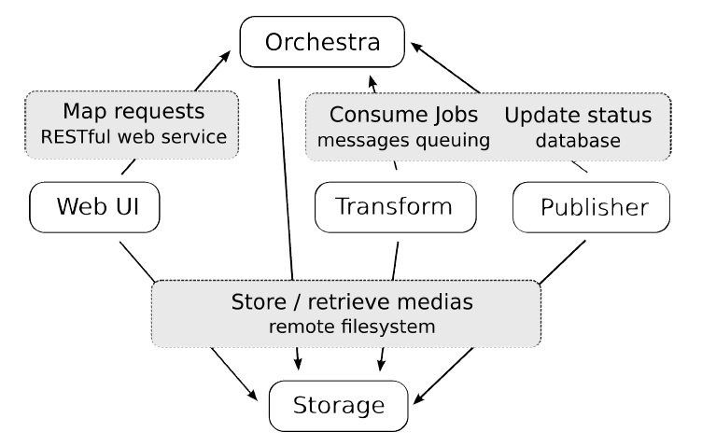
Current components of oscied

Slide 19
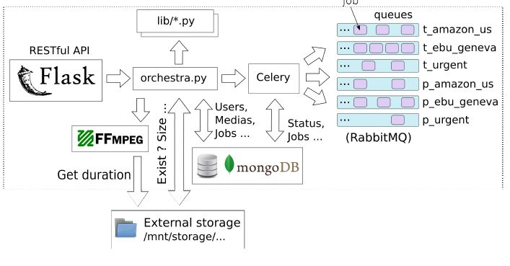
orchestrator

Slide 20
Orchestrator build
OSS Tools
• Flask Python Micro Web Framework
• PyMongo Python module for working with MongoDB
• MongoDB Scalable, High Performance NoSQL Database from 10gen
• RabbitMQ AMQP Message Broker from vmware
• Celery Distributed Task Queue
• JuJu Cloud Orchestrator from Canonical
Orchestrator manages all actions in OSCIED via:
• the RESTful API, to expose application’s functionalities to user
• the database, to store application’s data (users, profiles, jobs, ...)
• the message broker, to communicate with workers (transform & publisher)

Slide 21
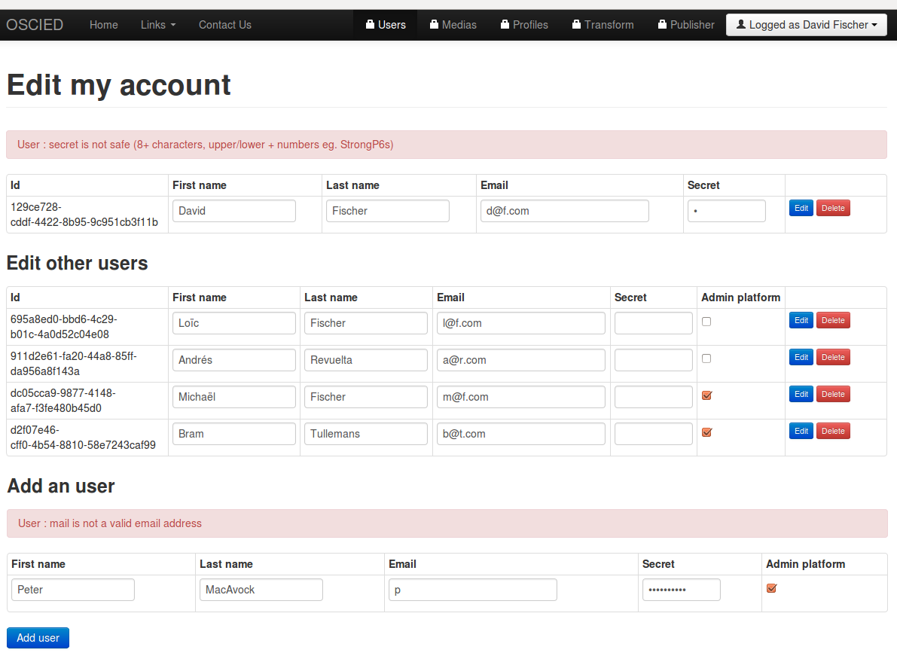
Account settings

Slide 22
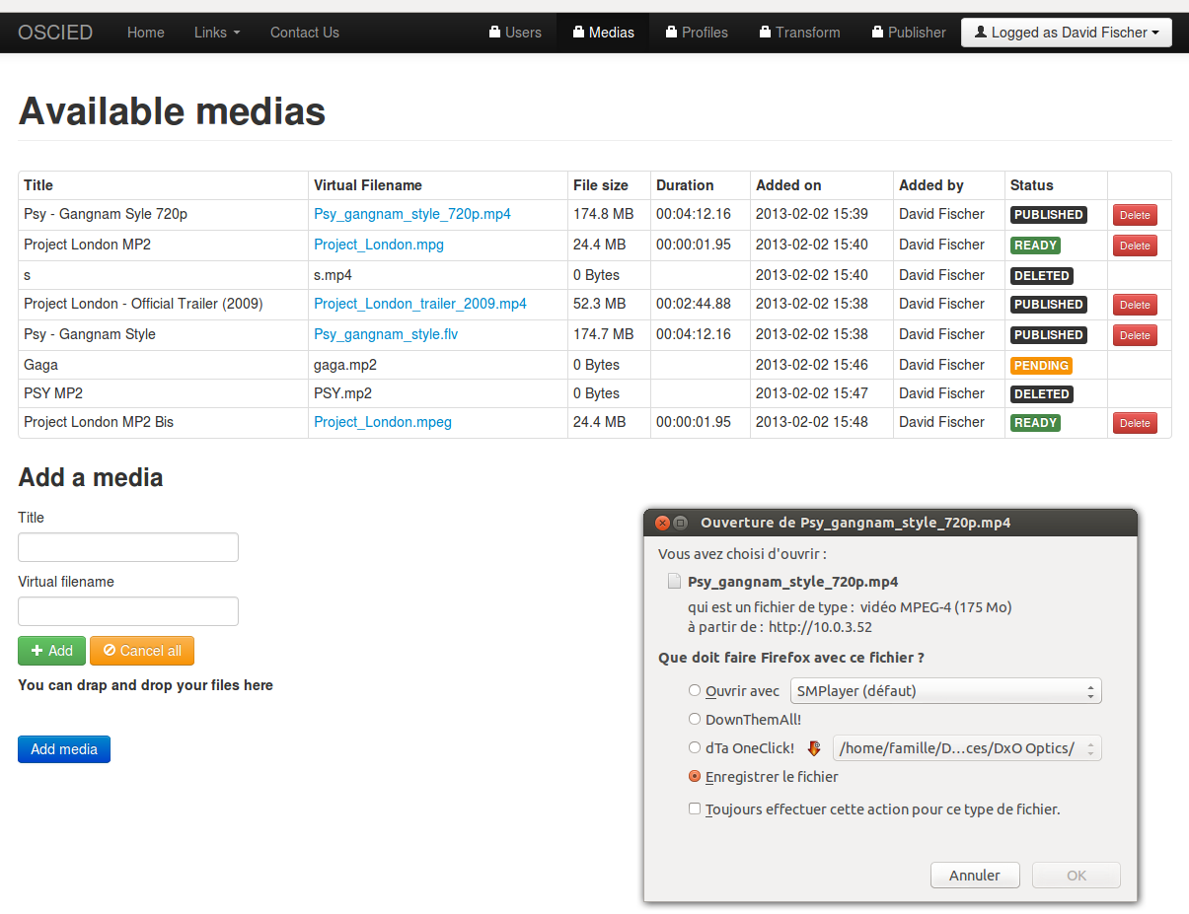
Imported media

Slide 23
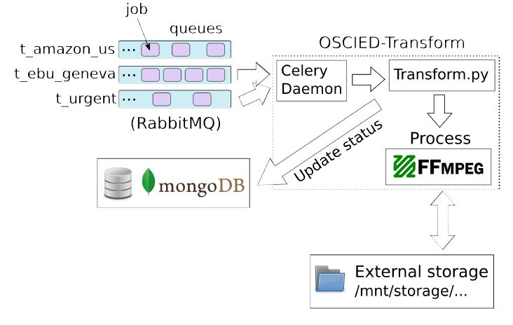
Transform unit

Slide 24
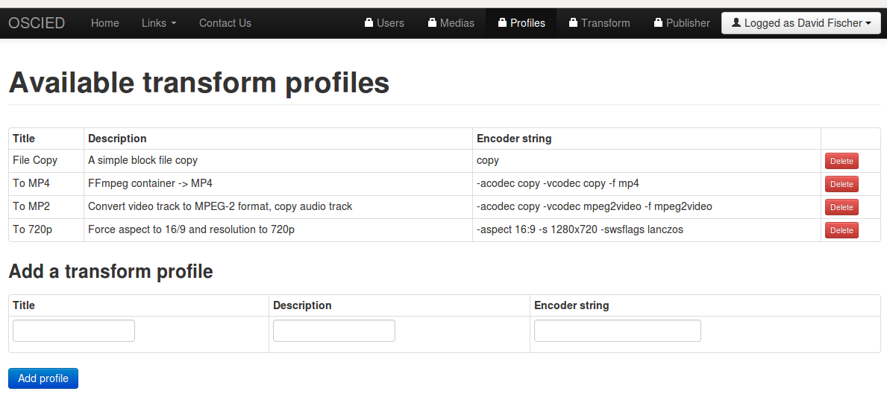
Encoding settings

Slide 25
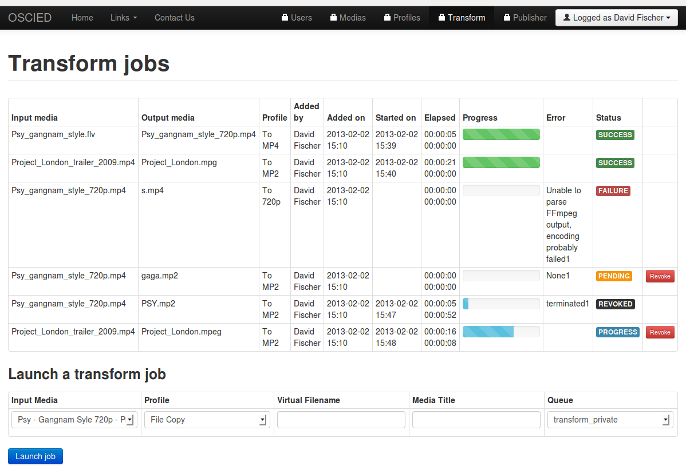
Encoding queue

Slide 26
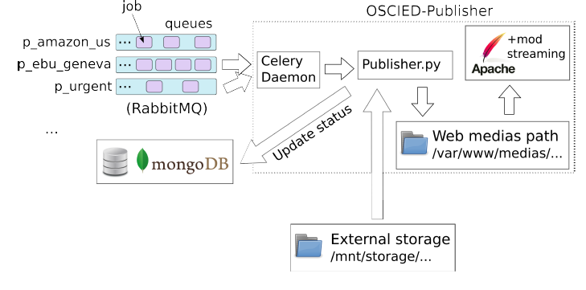
Distribution

Slide 27
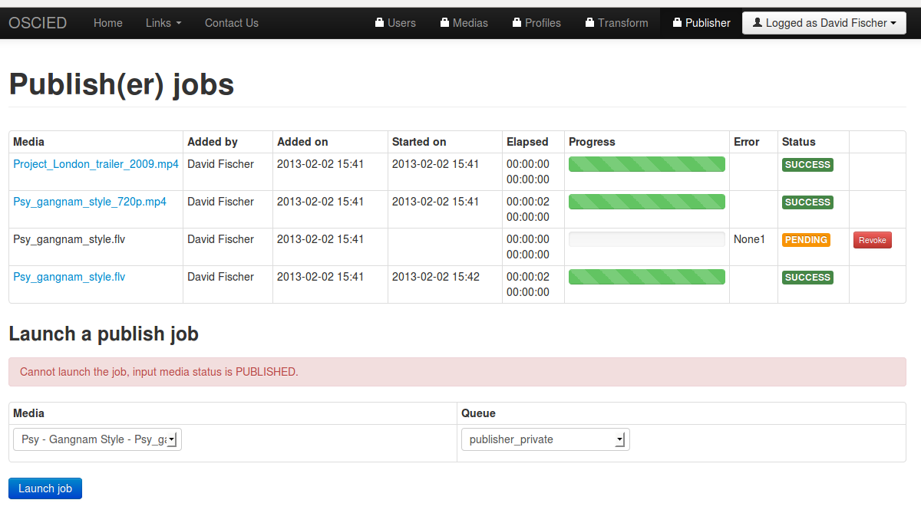
Distribution window

Slide 28
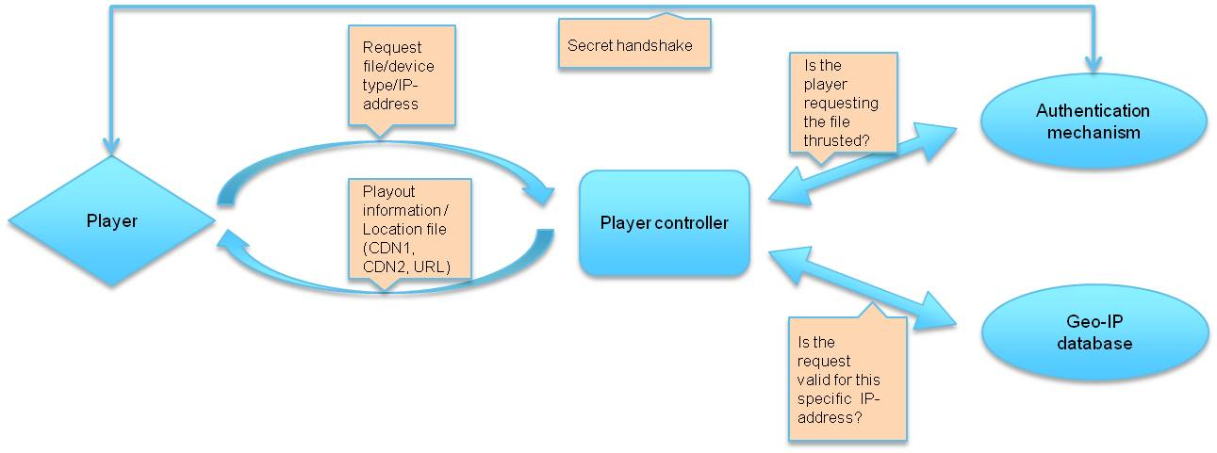
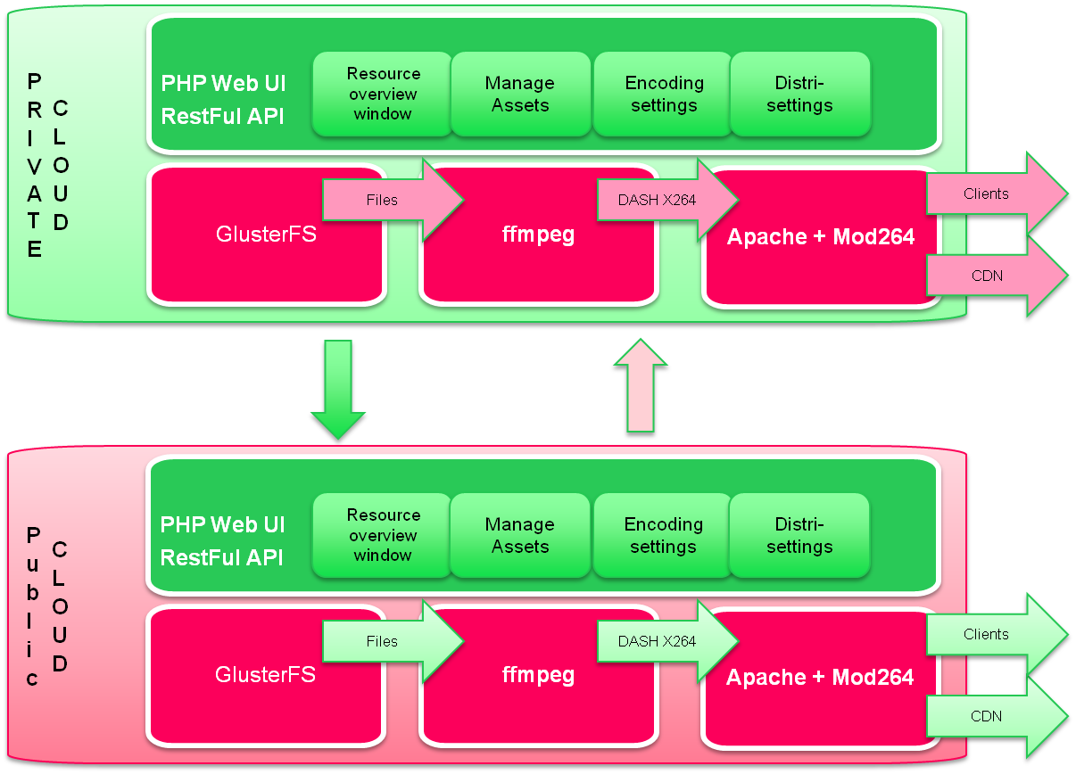
Media Asset management and Oscied*
Content Management System
4
3
Source (live feeds and MAM files)
1
2
Decentralised Content Management System
Decentralised Source (live feeds and files)
* Not available in basic version of OSCIED

Slide 29
Media asset management and oscied
OSCIED needs to be able to interface automatically with MAM backends in order to become useful in a professional environment
A source file is uploaded to the private cloud of OSCIED
The CMS sends a notification XML with details of the file that is uploaded (name, location, requested encoding profile and publication details)
The management layer of OSCIED will send a notification XML to the CMS when the file is available where in the distribution chain
The CMS will communicate with the Player Controller the locations of the files
It should be possible to ingest content directly in the public cloud of OSCIED, or from a external location to the private cloud.

Slide 30
Potential mediaflows
Internet Exchange
Real time metadata
Content over IP
SDI Live feed
Video feeds over IP
CDN2
CDN1
Real time metadata
ISP3
(Mob ile network)
ISP2
ISP1
EU
EU
EU
EU
EU
EU
D
D
D
D
D
D
D
D
D
D
D
D
D
D
D
D
D
D
D
D
D
D
D
D
D
D
D

Slide 31
Potential future work…
Connect different distribution outlets with automated distribution intelligence to optimise data flows from and to OSCIED
Distribution overlay: The management environment decides what the optimal data route is to distribute content from private or public OSCIED via IXPs, CDNs, ISPs, End User networks (EU) to specific devices (D).
Congestion in network avoided
Capabitlity of network is taken into account (for example if it can transcode content for playback on specific devices)
Distribution costs are taken into account (cost per GB or GB/s)
Communication overlay: Dataflows from end user devices (D) are aligned with those of the content provider and processed in the cloud or the network (for example active nodes in the CDN)
Synchronisation of media flows
Generating interactive interfaces to thin clients / devices with limited playback options
Upload of source files of media assets that are processed decentralised (remote editing, postproduction, etc.)

Slide 32
Player backend communication
Request file/device type/IP-address
Secret handshake
Is the player requesting the file thrusted?
Authentication mechanism
Player
Player controller
Playout information / Location file (CDN1, CDN2, URL)
Which route
What distribution
route is most
efficient?
Geo-IP database
Buffer underrun / ping speeds / start latency / sustained video speed (bitrate playout)
Is the request
valid for this
specific IP-address?
QoE / distrabution measurement
Start / stop moments in files that are played out
Audience measurement

Slide 33
More Future intelligence in oscied
Player backend functionalities and other feedback loops can be part of OSCIED in the future.
Player sends information to OSCIED that can be used for end to end monitoring of the IP-network. This information can be used to manage traffic flows, for example avoid a busy CDN at a certain moment.
Player sends information to OSCIED that can be used for audience measurement.
Player can request a media file for playback from OSCIED. The Player Controller of OCSIED checks:
If the player is authentic
If the player is used in an accepted location
What the best available location of the file is
Player receives an XML or MPD with information about either:
The location of a still informing that the file cannot be played out in that region
The location of the media files that can be played out from the easiest to reach cache

Slide 34
OSCIED = Work in progress…
Let me hear your thoughts!
Release date EBU OSCIED Github repository: 13 September
Come and see the OSCIED demo at IBC (EBU booth hall 11)
For more information mail:
Bram Tullemans (tullemans@ebu.ch)
Special thanks to OSCIED developer David Fischer

